Slide 1

Improving Retention Rates &
Student Support at OU
Jeff Blahnik
Executive Director
OU Admissions & Recruitment
Casey Partridge
Associate Director
OU Graduation Office

Slide 2
Freshman Application Growth

Slide 3
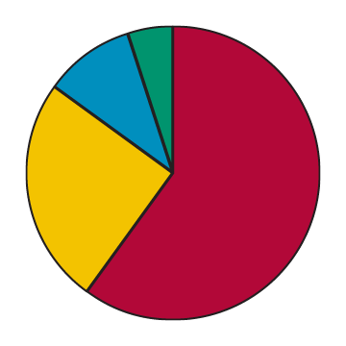




Holistic Application Process
Academics
Involvement
Essay
Letter of Recommendation

Slide 4
Other Success Considerations
Grade trends combined with academic rigor
Academic preparation in stated area of academic interest
Interactions with our department and on social media
Demonstrated grit
Average grade erosion
Identification of other risk factors
Note: Office of Admissions and Recruitment is more adept at identifying financial and academic challenges now

Slide 5
Possible Admission Decisions
Admit
Admit with graduation coach
Admit into Sooner Rose program
Waitlist
Spring offer
Deny

Slide 6
Sooner Success Coaching Program
Established in 2009 out of a retention task force committee
Blended academic advising into our coaching model in 2012
Progression of retention for program

Slide 7
Student Success Outcomes
1
2
3
4
Cultivating a
growth mindset
Building trust
Developing
self-awareness
Taking action by seeking resources

Slide 8
Academic Life & Money Coaching
Certified life coaching program initiated in 2015
Development of academic advisers across campus
Money coaching in partnership with our Student Financial Center

Slide 9
Next Steps
Coaching access for
all students
Continue life coaching program and workshops
Creating a coaching culture

Slide 10
Retention Rate Over Time

Slide 11
A Framework of “Leavers”
Who leaves?
  Data analysis of several years of students that left, comparing their attributes to those who stayed
Predictive factors collapse into four categories:
Academic Skills
Social/
Connectedness
Financial
Grit/
Perseverance

Slide 12
Improving Retention: Stage 1
Associate Provost for Academic Advisement Oversight position created
Think 15 campaign
Gateway to College Learning courses
Center for Student Advancement (University College)

Slide 13
Improving Retention: Stage 2
Graduation Office begins to coach at-risk students
  Any student on a “contract” gets a coach
    Really increase success rates of at-risk students, but creates a “trough” of students
    Those students needed mentoring—advisors fill that void
Academic Advisement Resource Center (AARC)
Major advisement (to combat “major swirl”)
Need-Based Aid
  Outreach to students with large balances
  Scholarship fund for students working more than 25 hrs week

Slide 14
Improving Retention: Stage 3
Careful quantitative analysis
  The amount of students in financial stress was saddening
    Retention scholarships
  Having a connection point at OU is important
    Freshman advisers
      Move from urgent care approach to mentor approach
      Academic life coaching program
      MyMajors
    Faculty Group—Elite Retention (ER) Squad
      Meet regularly to discuss how to best teach freshmen
      Agree to turn in mid-term grades
    Graduation Office initiatives
      MapWorks survey of freshman during third week
      Outreach to non-enrolled students (War Room group)

Slide 15
Questions?
Let’s talk.
Jeff Blahnik
Executive Director
OU Admissions & Recruitment
Casey Partridge
Associate Director
OU Graduation Office

