Slide 1
A Counselor’s Role in School Safety
Michelle Sutherlin
School Counselor, Norman North High School
Instructor, Oklahoma School Security Institute

Slide 2
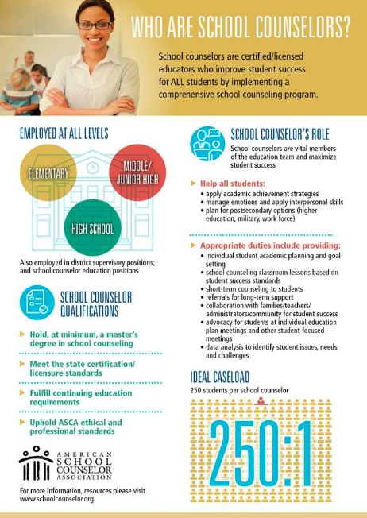

Slide 3
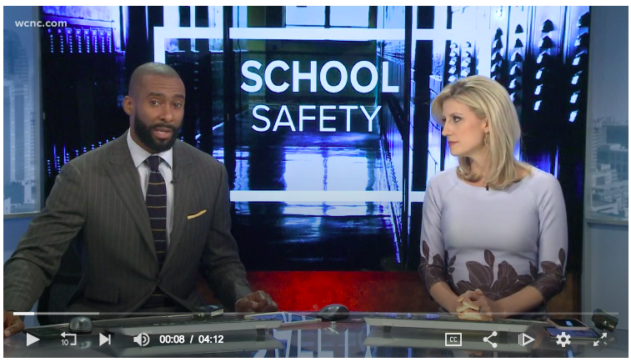

Slide 4
Where are we today?
Violence
School Shootings
Sexual Assault/Rape
Relationship Violence
Other Personal Crimes
Etc.

Slide 5
Is it worse now than it has ever been?

Slide 6
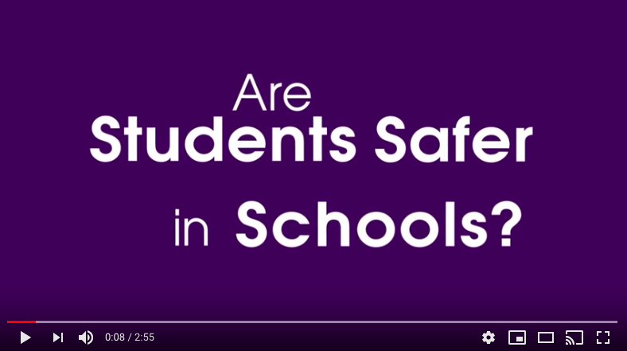

Slide 7
Data
In 2014, there were more than 850,000 nonfatal victimizations (including assaults, thefts and other incidents) among students ages 12 to 18 at schools across the United States.
About 7 percent of U.S. high school students reported being threatened or injured with a weapon such as a gun or knife on school property in 2013.
National Center for Educational Studies

Slide 8
Data
In 2013, approximately 22 percent of U.S. students ages 12 to 18 reported being bullied at school during the school year. Females reported higher percentages of being made fun of, being called names or insulted, being the subject of rumors or being excluded from activities on purpose. A higher percentage of males reported being pushed, shoved or tripped at school.
In 2013, about 8 percent of U.S. high school students reported being involved in a physical fight on school property during the past year.
National Center for Educational Studies

Slide 9
Data
In 2013, approximately 7 percent of U.S. students ages 12 to 18 reported being cyberbullied during the school year. A higher overall percentage of female students reported being victims of cyberbullying.
In the 2013-2014 school year, about 88 percent of U.S public schools had a written plan for response procedures in the event of a shooting; 70 percent of those schools with a plan had drilled students on the use of the plan.
National Center for Educational Studies

Slide 10
Recent Survey
Our school recently surveyed both students and staff about school climate and safety. The results were similar.

Slide 11
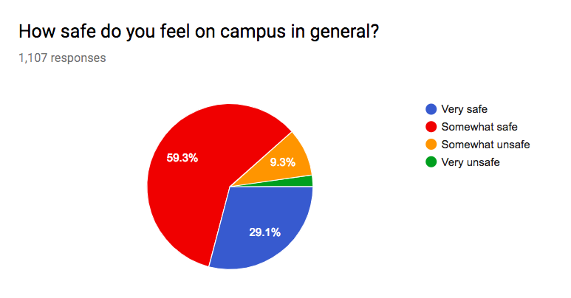
Recent Survey
Student Survey

Slide 12
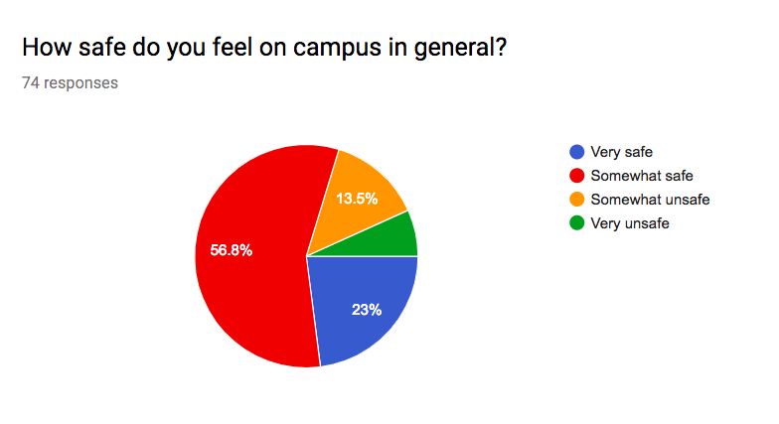
Recent Survey
Staff Survey

Slide 13
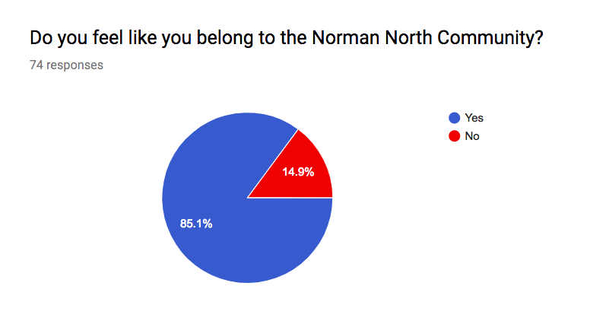
Recent Survey
Belongingness

Slide 14
What can we derive from our data?
Between 80-90% of students and staff feel very safe or somewhat safe.
What about the 10-20% who don’t?

Slide 15
The Situation
Even though crime is down, social media and news media make it appear that crime is up.
School safety and security issues are at our fingertips all the time.
There’s more fear than ever before.
So what can we do?

Slide 16
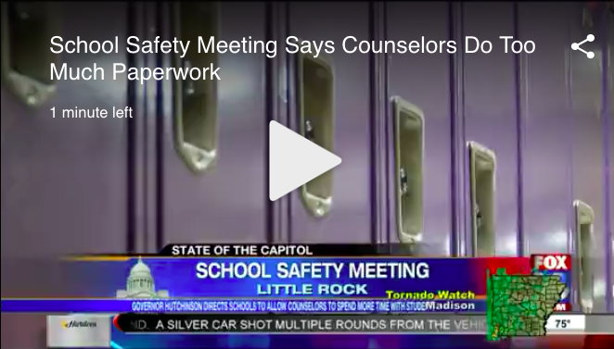

Slide 17
“Another $58 million in the Education Department’s budget request … would add more school counselors to support student with college and career planning, as well as hardships.”
“Hofmeister’s new education budget request seeks to reduce class sizes, invest in more school counselors”, Tulsa World, Oct. 25, 2018

Slide 18
New Counselor Money
This proposed money has been approved by the State Board of Education and now moves to the Capital.
This money would move the counselor-student ratio in Oklahoma to be in line with the ASCA model at 250:1.

Slide 19
A Counselor’s Role in School Safety
Know Who is At Risk
Climate and Culture
Mental Health Awareness
Student Advocacy
Relationships & Belongingness
Crisis Plan and Response

Slide 20
Know Who is At Risk
How are you tracking your at risk students?
What data are you looking for?
Are you looking consistently?
What interventions are in place for At Risk students?

Slide 21
Know Who is At Risk
EL or SPED
Free or Reduced Lunch
Ineligible for 4 weeks or more
Failed a class last semester
5 days or more suspended
Attendance lower than 92.5%

Slide 22
Know Who is At Risk
3 is considered At Risk
4 or more is considered Highly At Risk

Slide 23
Interventions
PBISWorld.com
Check in/Check out
Drag sheets
Mentors
Social/emotional small groups
Social skill building
Etc.

Slide 24
Interventions
Counselors should not hesitate to call DHS or Police.
1-800-522-3511

Slide 25
Mental Health Awareness
Are you talking about it?
Guidance lessons
Suicide prevention
Training the adults
Awareness weeks/months
Clubs/activities

Slide 26
Mental Health Awareness
Check ins with students
Emergency Notifications
Contacting parents/guardians
Working with SROs/Police
504s and IEPs
Re-Entry Meetings

Slide 27
Student Advocacy
When a student needs something - even if it is in-patient treatment - don’t be afraid to fight for it
Working with teachers/other staff members to do what’s best for each child

Slide 28
Climate & Culture
What system is in place in your school to address Climate & Culture?
Is there a focus at your school?
Counselors should be champions of climate & culture

Slide 29
Climate & Culture
School-wide practices
Rewards vs. Punishment
Restorative practices
Etc.

Slide 30
Relationships & Belongingness
Students need to feel as if they belong for us all to stay safe

Slide 31
One Study
“This study examined the relationship of students' perceptions of school safety and school avoidance related to feeling unsafe with predictor variables: bullying victimization, student/teacher/parent/administration relations, rule clarity and consistency, school physical environment (negative and positive), and student's belongingness.”
J Sch Nurs. 2018 Aug;34(4):319-330. doi: 10.1177/1059840518761792. Epub 2018 Mar 14.

Slide 32
One Study
“In a public high school sample ( n = 585), 24.7% of students felt unsafe and 14.4% avoided school due to feeling unsafe during the past month. Being female and experiencing bullying was associated with feeling unsafe. However, after accounting for demographics and bullying victimization, perceptions of safety increased when students reported positive student and teacher relations, consistent rules, a clean school that is also crowded/noisy, and a sense of school belonging.”
J Sch Nurs. 2018 Aug;34(4):319-330. doi: 10.1177/1059840518761792. Epub 2018 Mar 14.

Slide 33
One Study
“Avoiding school because of safety concerns was related to decreased school belonging and teacher/student relationships, but not bullying. Focusing on enhancing the school climate/environment, facilitating student belongingness, and reducing bullying are ways school(s) … can help promote safer schools.”
J Sch Nurs. 2018 Aug;34(4):319-330. doi: 10.1177/1059840518761792. Epub 2018 Mar 14.

Slide 34
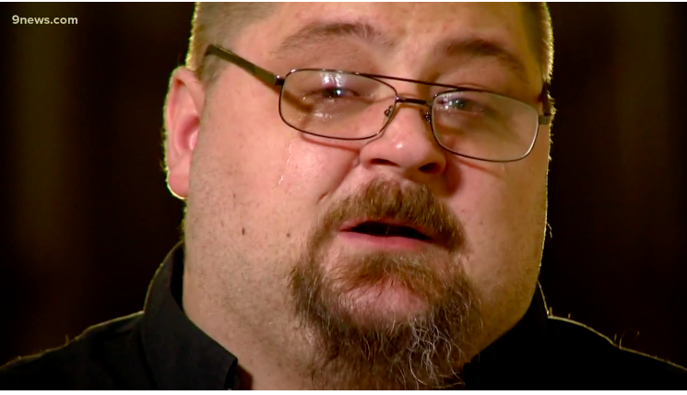

Slide 35
Relationships & Belongingness
Sports
Clubs
Fine Arts

Slide 36
Relationships & Belongingness
Knowing your students
Call them by their names
Know something about their lives
Know their families
Counsel them!
Understanding the impact of trauma

Slide 37
We shouldn’t be asking, “What’s wrong with you?” We should be asking, “What happened to you?”

Slide 38
Crisis Plan and Response
Strive for excellence in crisis response.
This means you must plan ahead.

Slide 39
Crisis Plan and Response
Do you have a crisis plan?
If so, do you know your role?
Have you ever practiced? Had a table top?
There’s no cookie cutter plan. Every school is different.
Serve on your school’s crisis team.

Slide 40
If you see something, say something. Until someone listens.

Slide 41
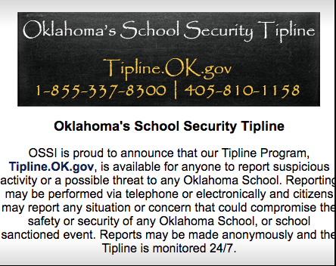
Crisis Plan and Response

Slide 42
A Counselor’s Role in School Safety
Michelle Sutherlin
msutherlin@norman.k12.ok.us
405-659-7078

