Slide 1
Hosting a Conference for Students
Preparing them for the Next Step!

Slide 2
Why?

Slide 3
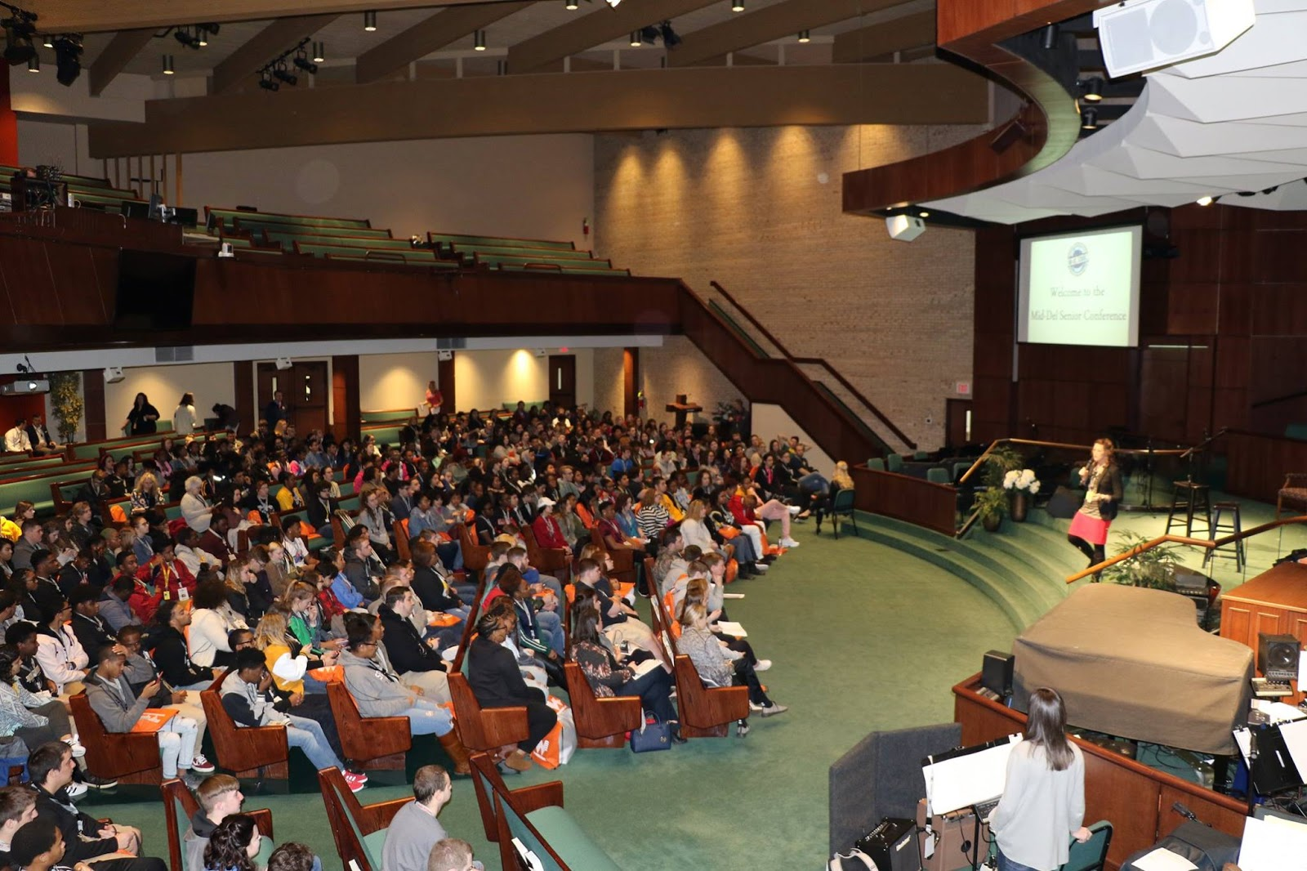

Slide 4
Things to Keep in Mind
NO Budget
Size of District/School
3 High Schools with 850 – 900 each class
Team Effort

Slide 5
Step 1: TEAM Effort!
Location & Security / Transportation
Event Schedule (Start & End Times, Number of sessions, Lunch, etc.)
Topics for each session
Keynote Speaker
Lunch
Set-up, Signs, Clean-Up
Identify people to help with registration, runners, etc.
Hospitality room for presenters
Lanyards & Swag Bags
Strategic Help Desks

Slide 6
Step 2: Finalize Schedule
Arrival Time for Lead Team
Volunteers & Session Facilitators Meeting
Arrival Time for Presenters
Arrival Time for Students (Bus Transportation, if applicable)
Keynote Speakers & Sessions
Lunch
Closing & Dismissal

Slide 7
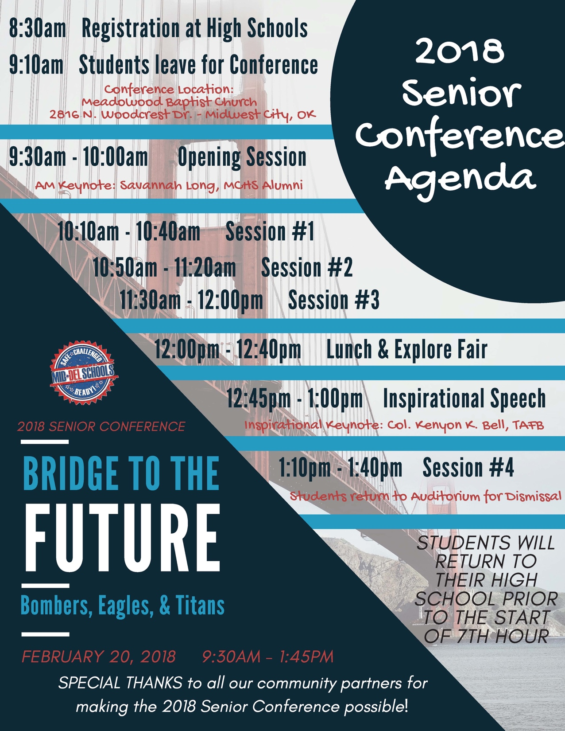

Slide 8
Step 3: Contact Presenters & Community Partners
Session Title & Descriptions
Presenter Bios
Technology Needed
Map & Information for Arrival

Slide 9
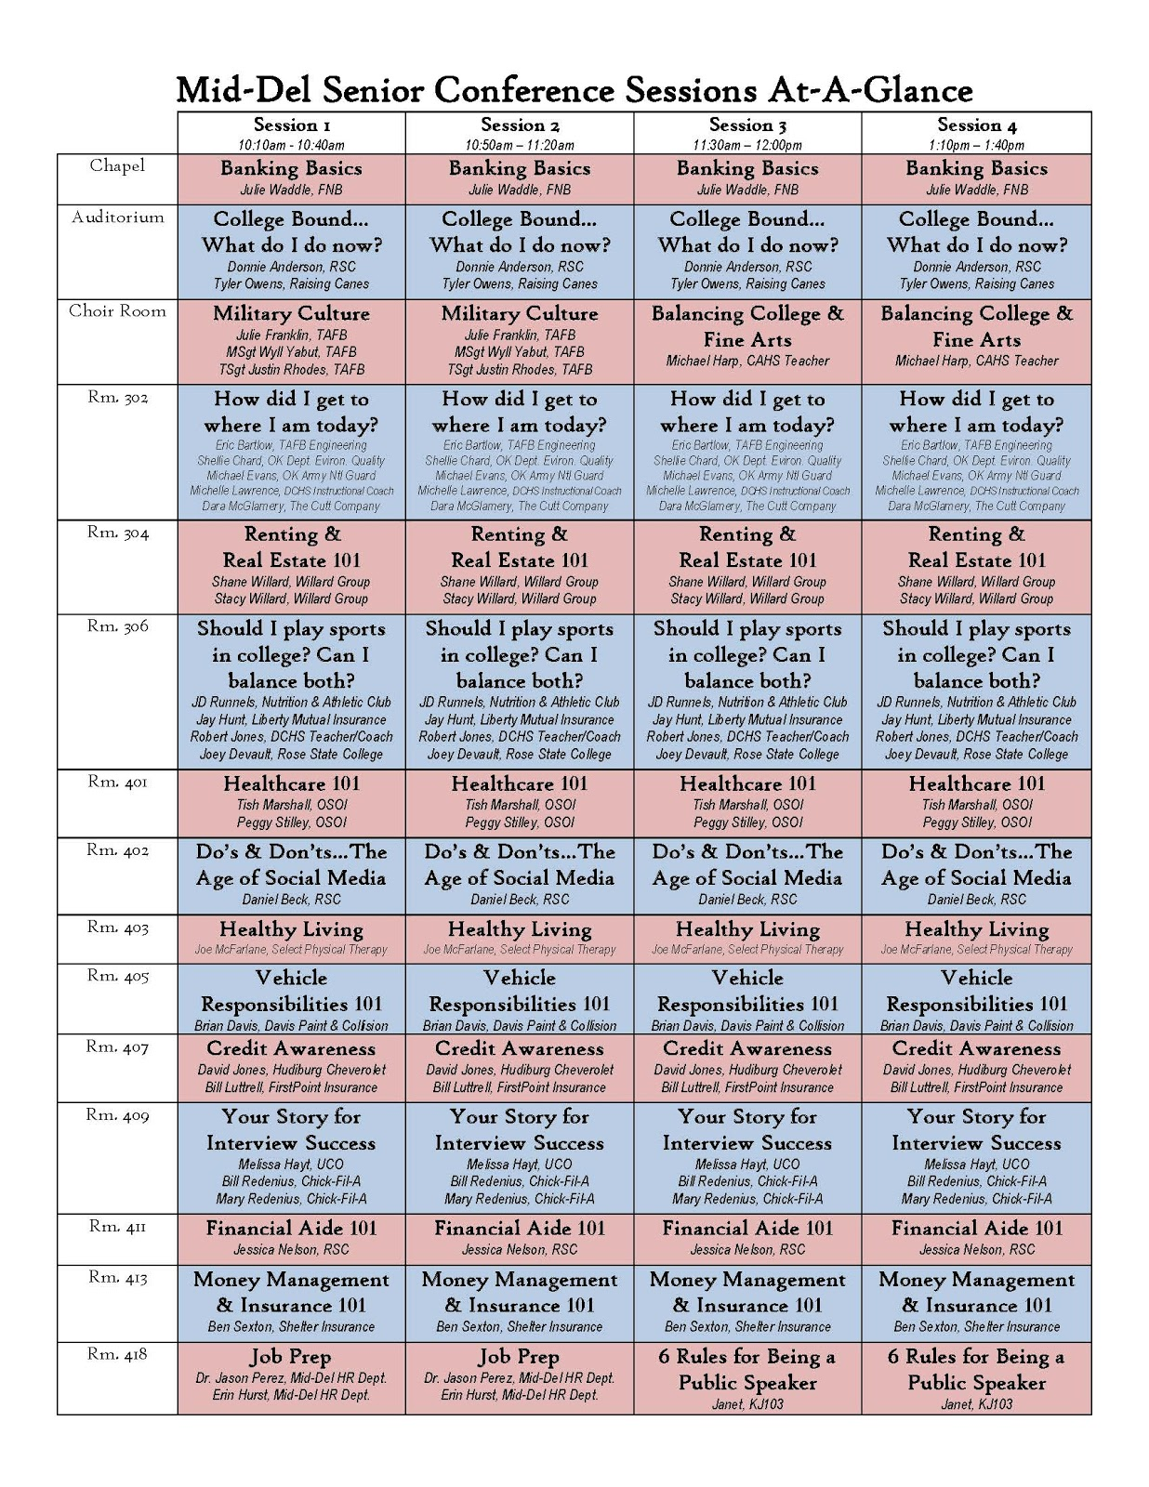

Slide 10
Step 3: Contact Presenters & Community Partners
Session Title & Descriptions
Presenter Bios
Technology Needed
Information for Arrival

Slide 11
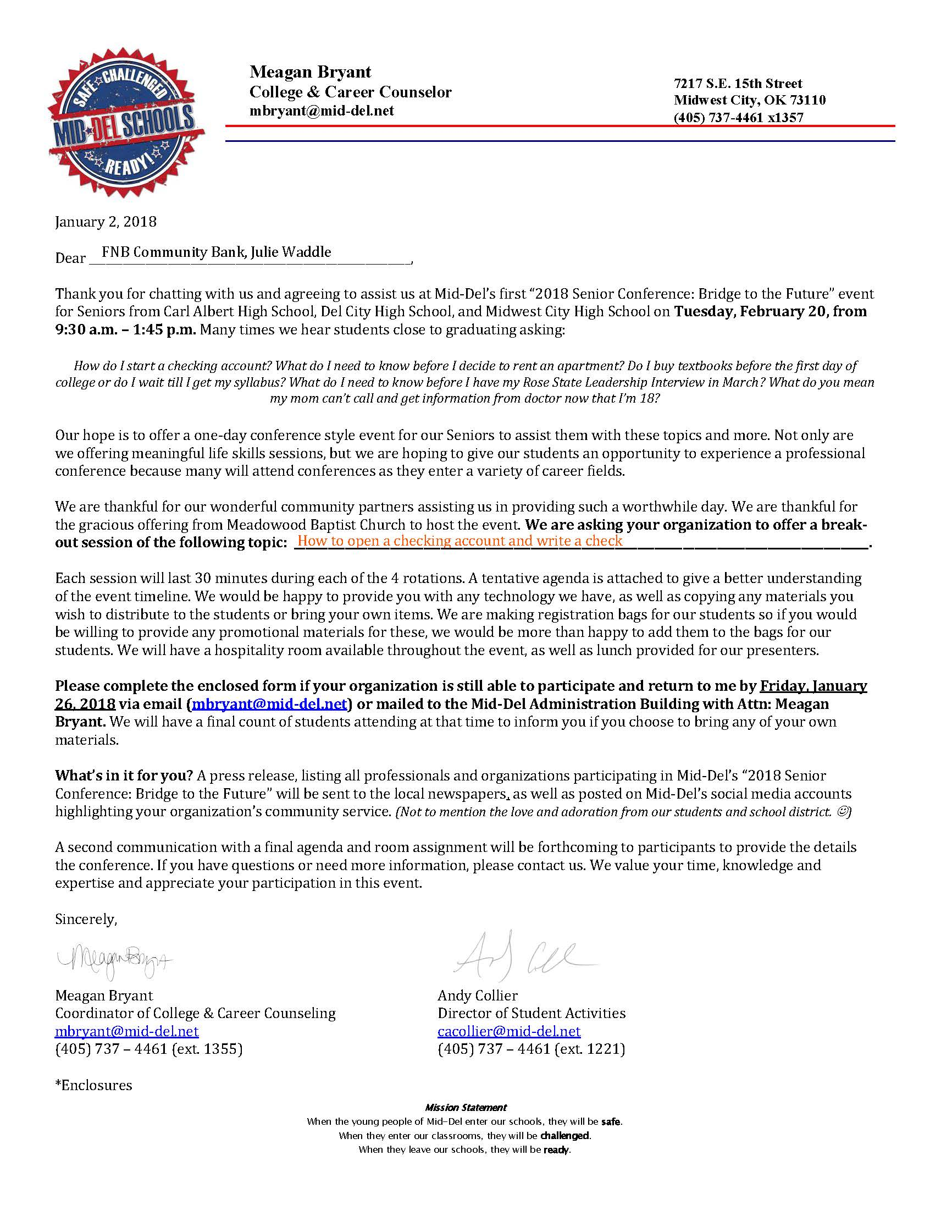

Slide 12
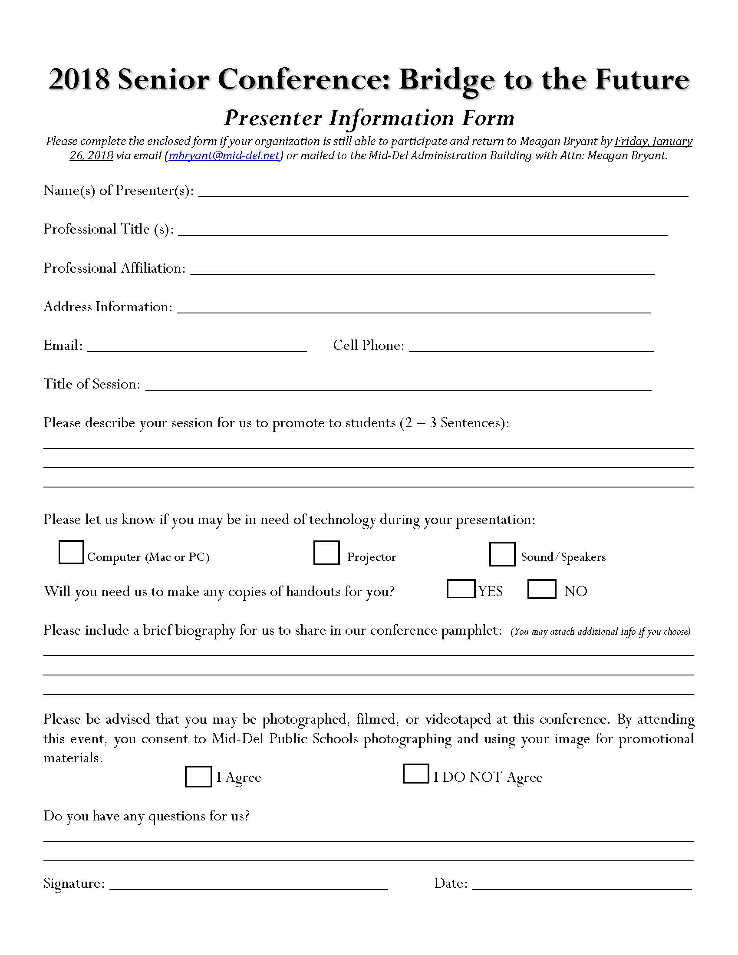

Slide 13
Step 4: Contact & Provide Explore Fair Opportunities
Colleges & Universities
Businesses for Job Opportunities
Military Recruiters
Voter Registration Table

Slide 14
Step 5: Session Scheduling
Max Number of Students Per Session
Session Facilitators
Technology Needs

Slide 15
Step 6: Information to Students & Parents
Eventbrite Registration
Informational Newsletter and Flyers
Promotional Videos on Social Media
Willard Group FNB Community Bank Ben Sexton Insurance

Slide 17
Step 6: Information to Students & Parents
Eventbrite Registration
Informational Newsletter and Flyers
Promotional Videos on Social Media
Willard Group FNB Community Bank Ben Sexton Insurance

Slide 18
Step 7: Day of Event Materials
Program & Swag Bag for Students
Name Badges for Students, Presenters, Volunteers, etc.
Maps for Presenters and Media
Signage for Session Locations
Folders of Info for Session Facilitators
“Thank You” Treat for Presenters

Slide 19
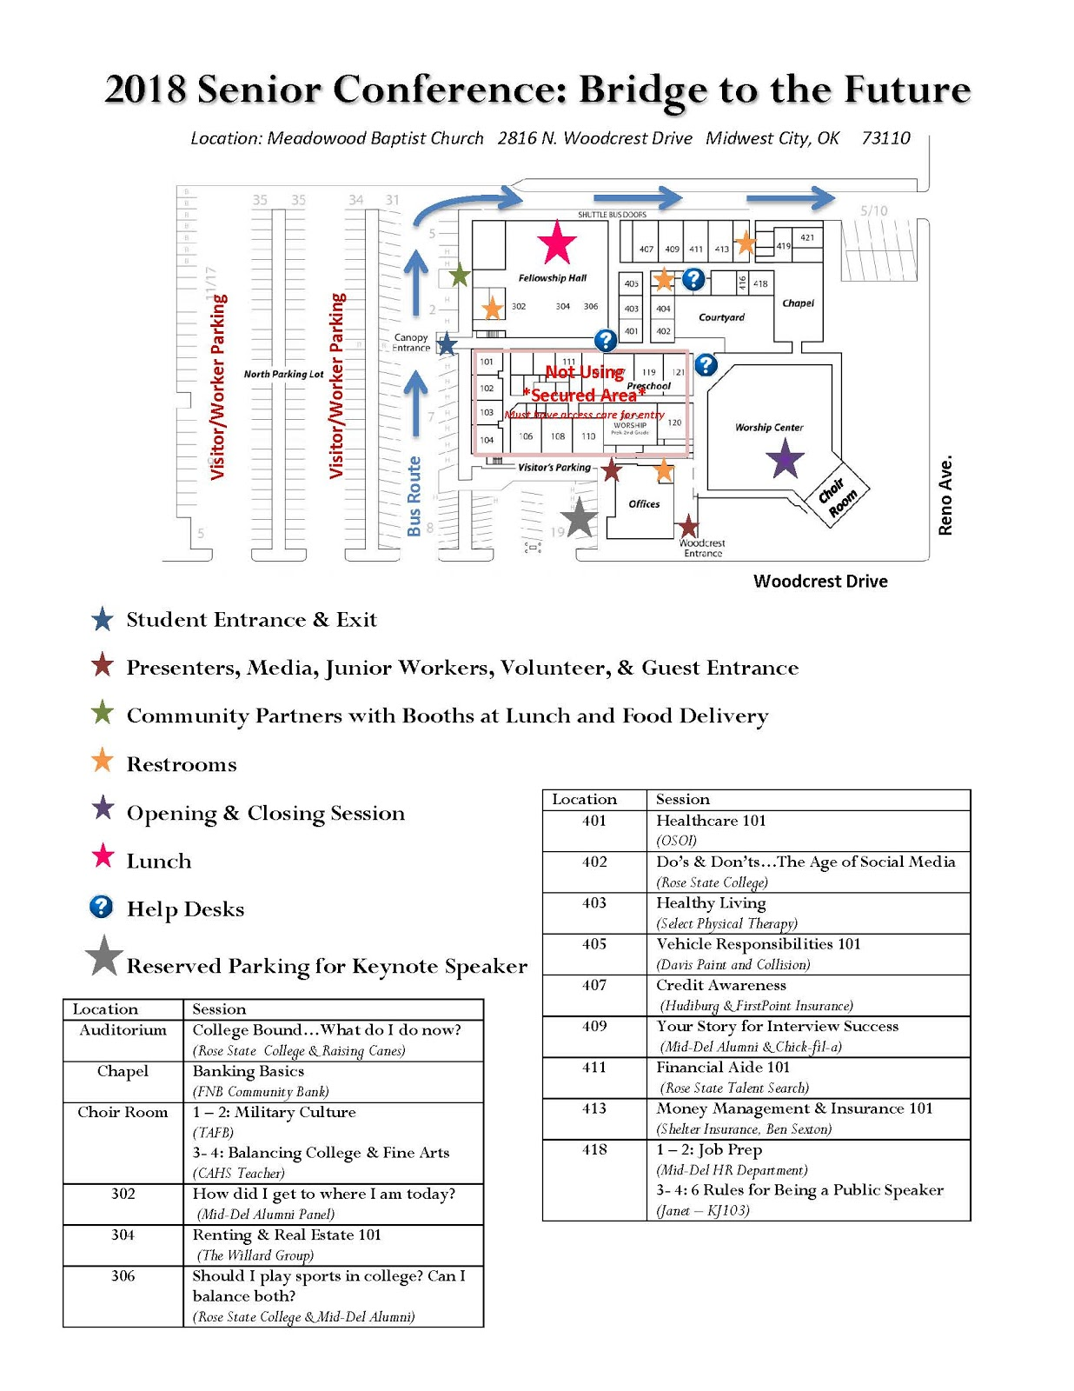

Slide 20
Step 8: Follow-Up
Student Survey
Presenters Survey
Lead Team Debriefing

Slide 22
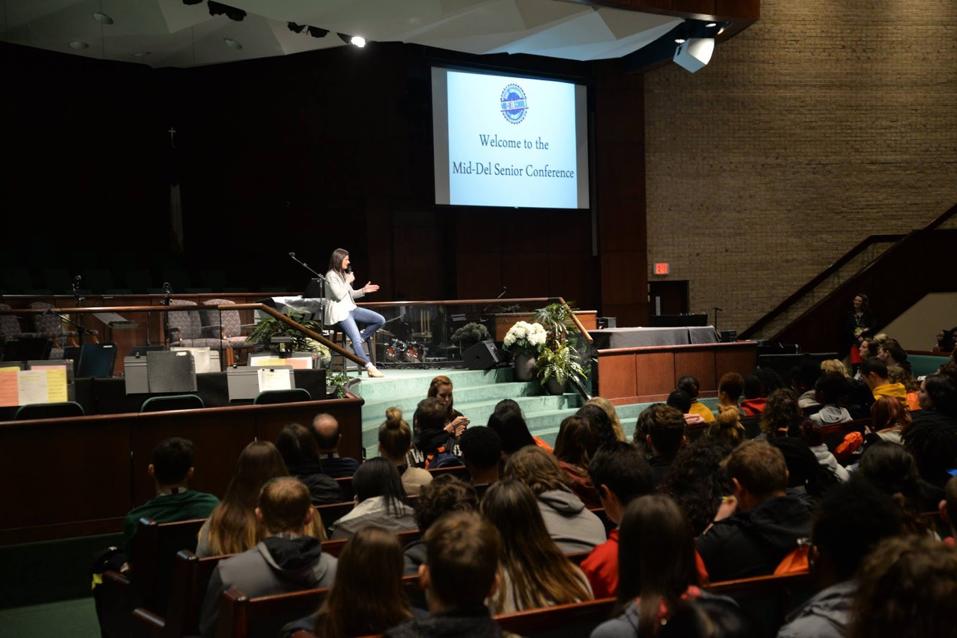

Slide 23
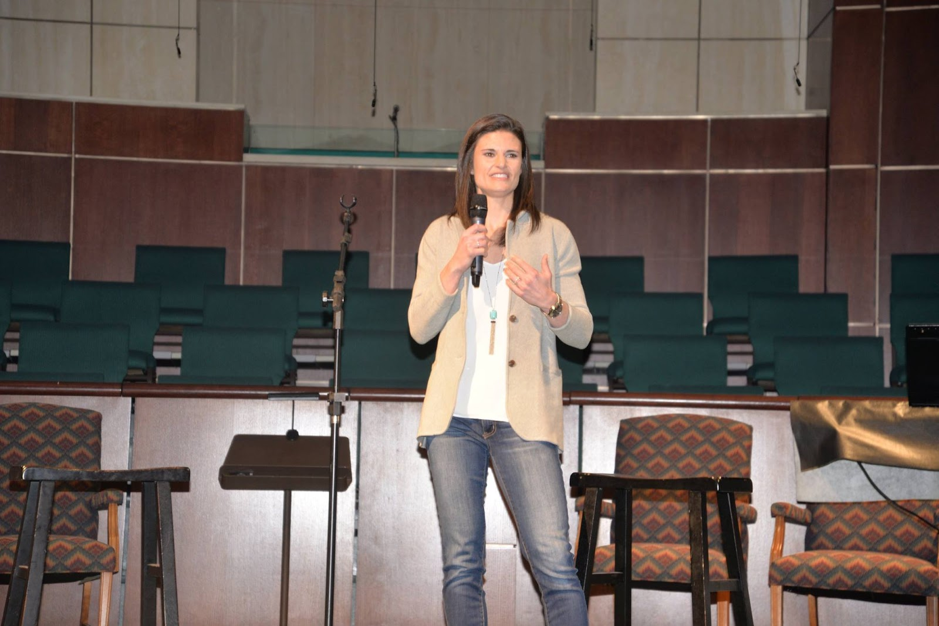

Slide 24
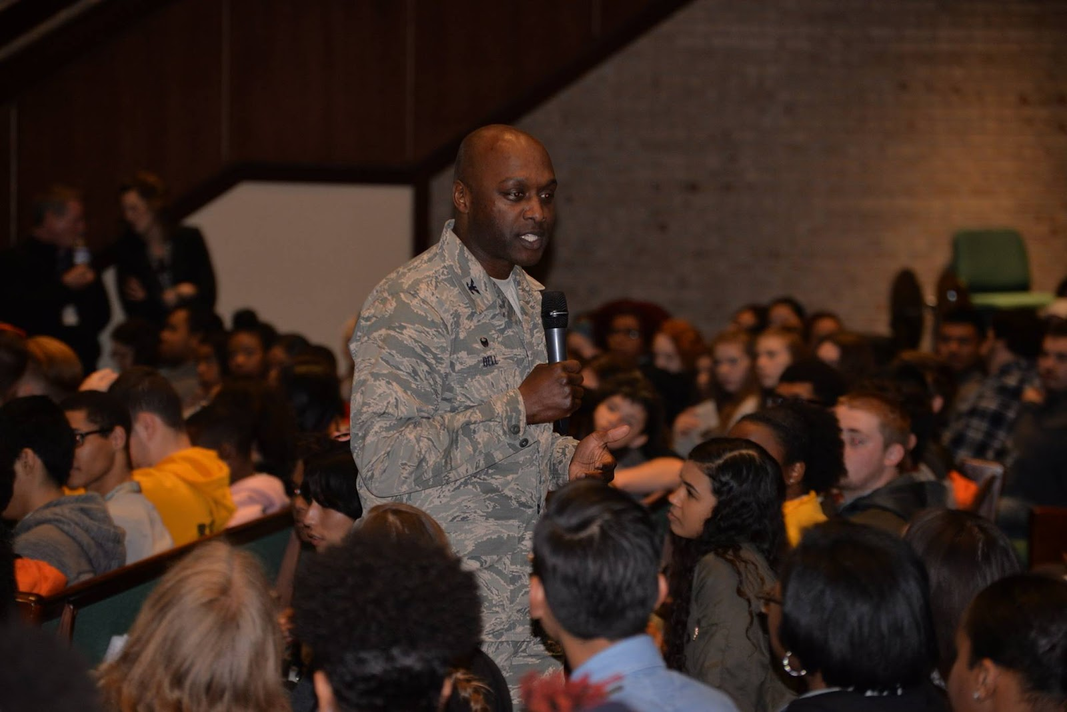

Slide 25
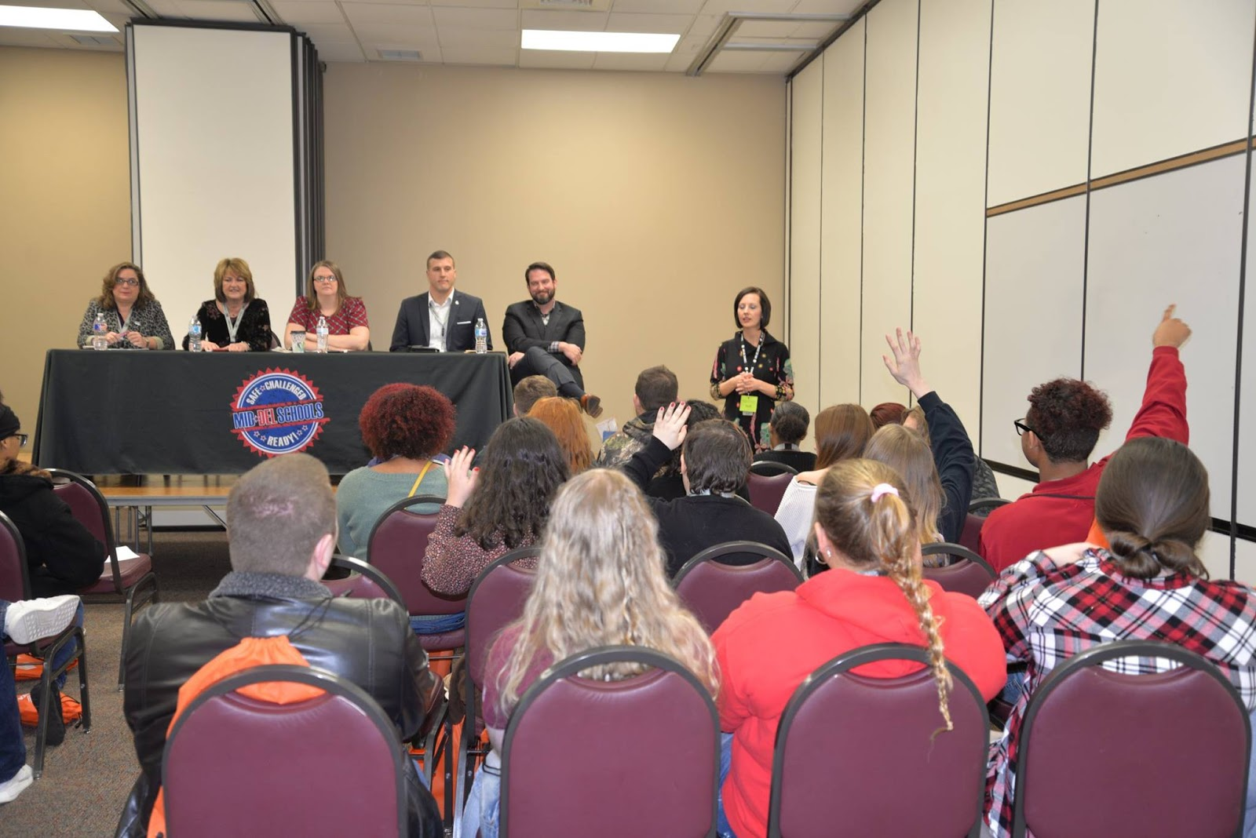

Slide 26
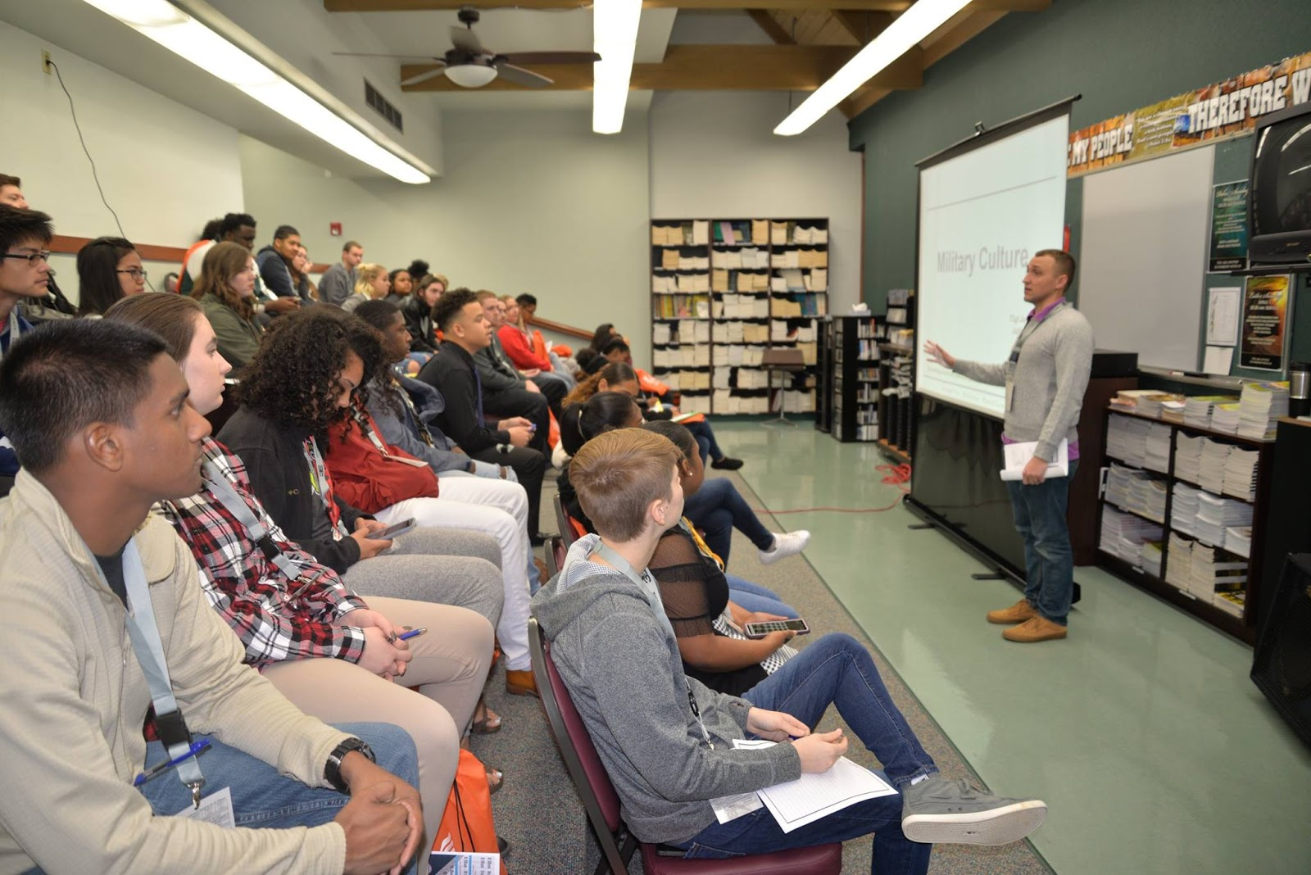

Slide 27
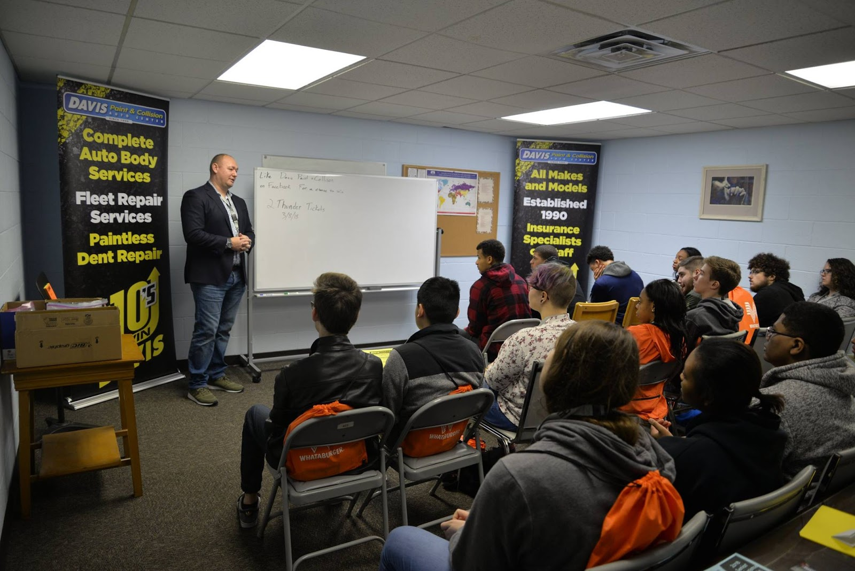

Slide 28
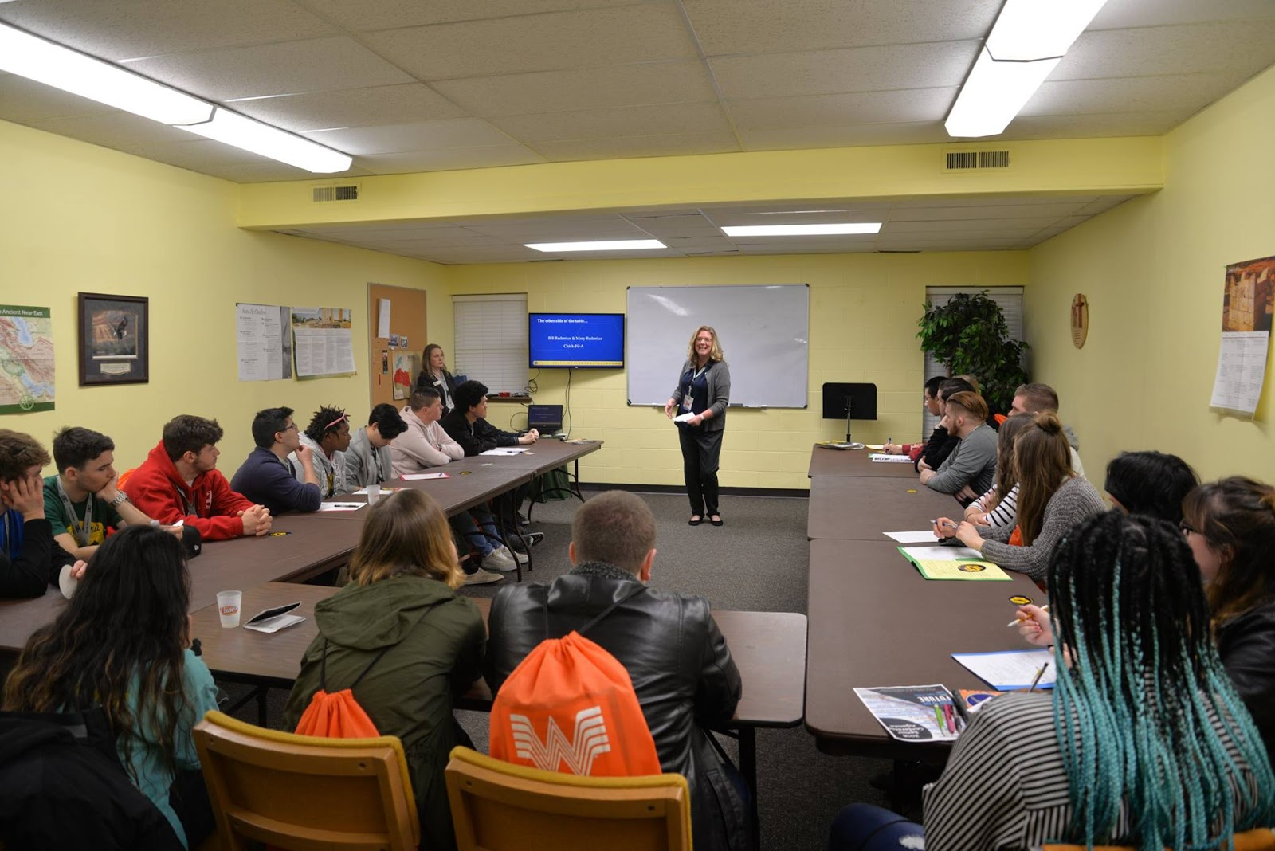

Slide 29
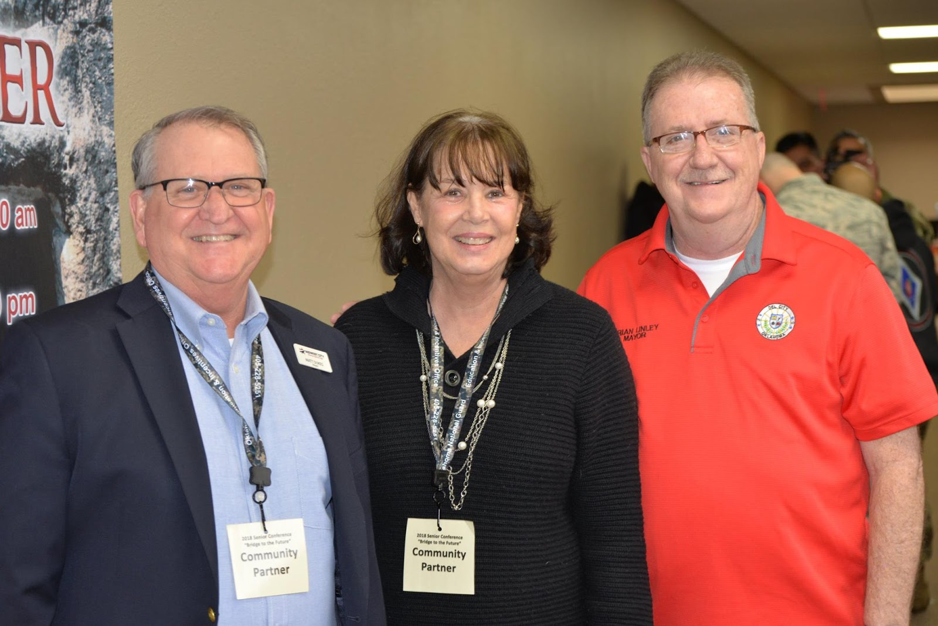

Slide 30
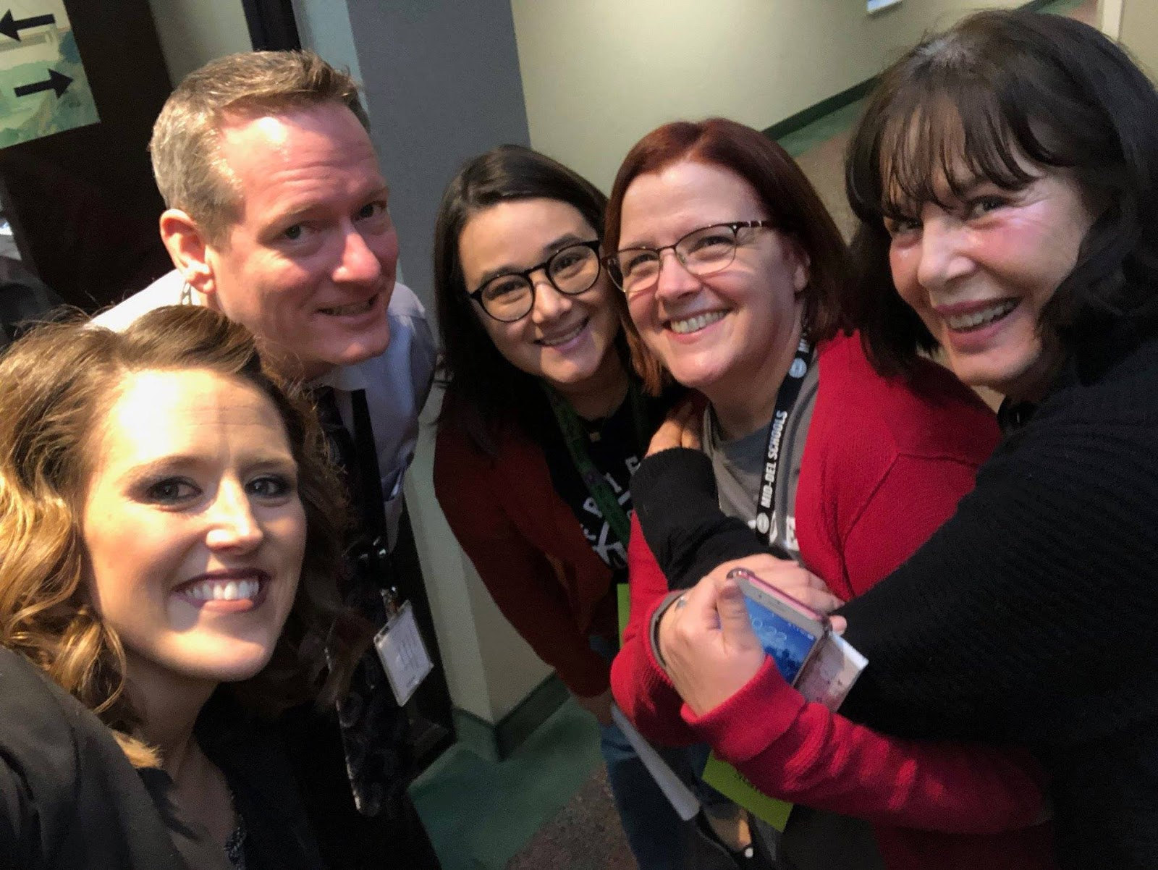

Slide 31
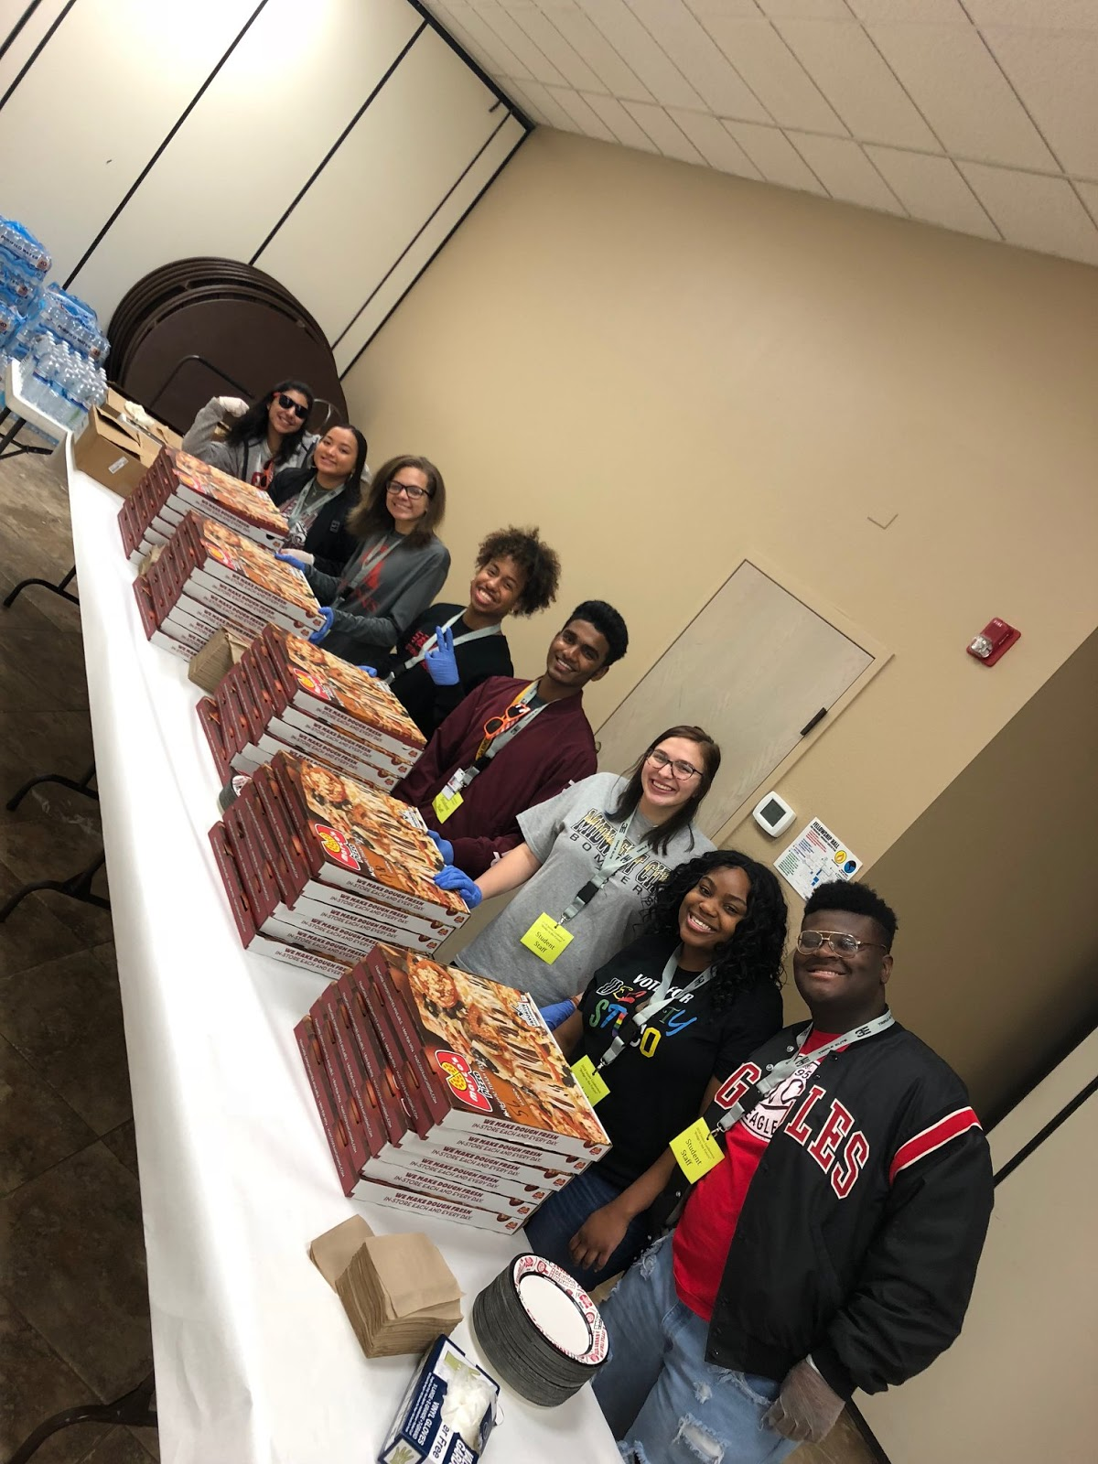

Slide 32
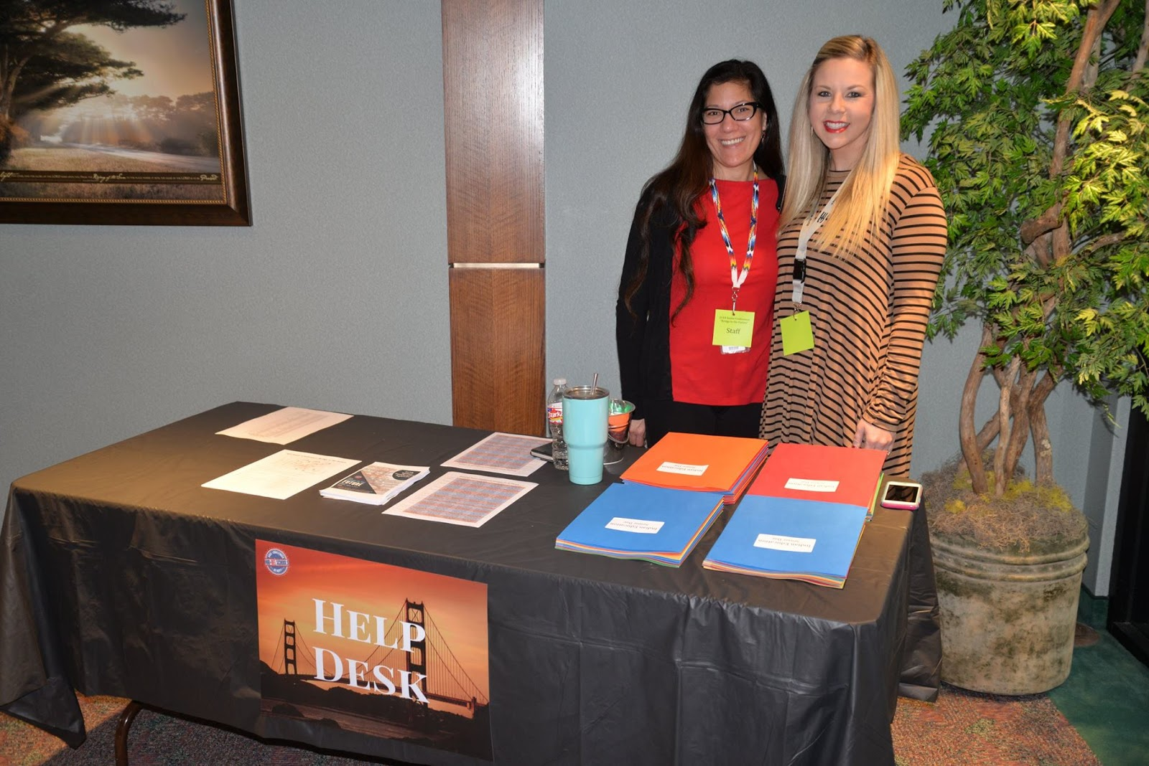

Slide 33
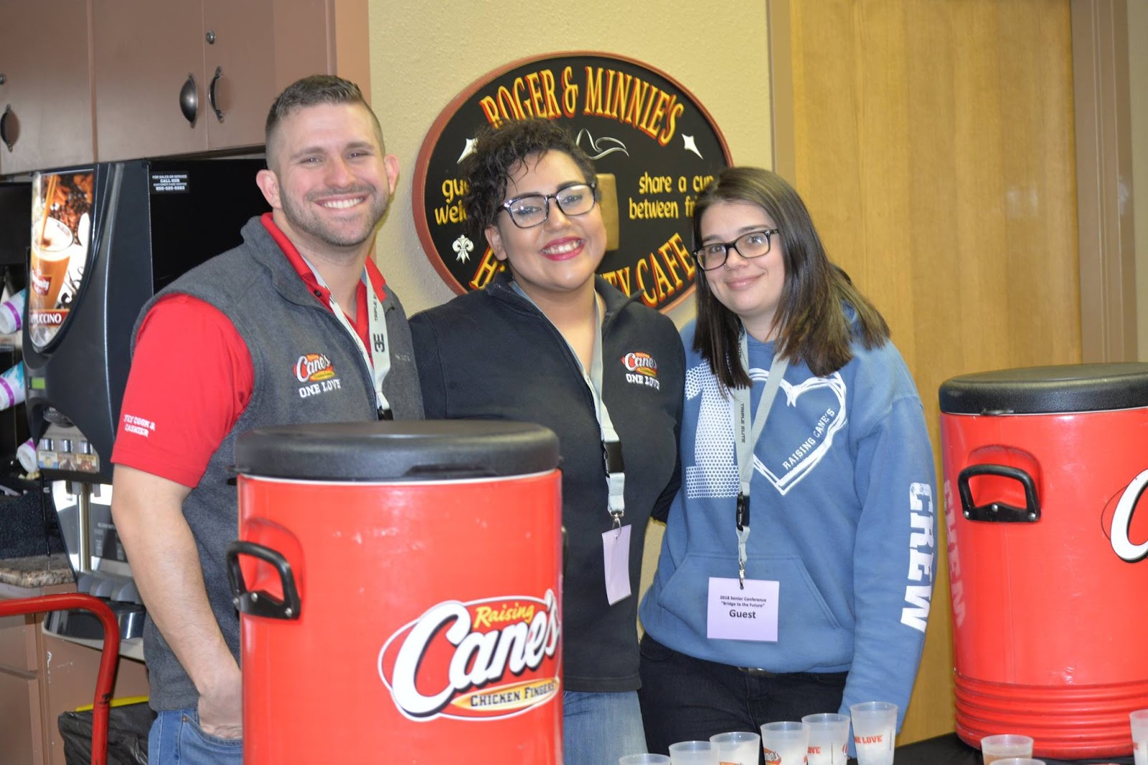

Slide 34
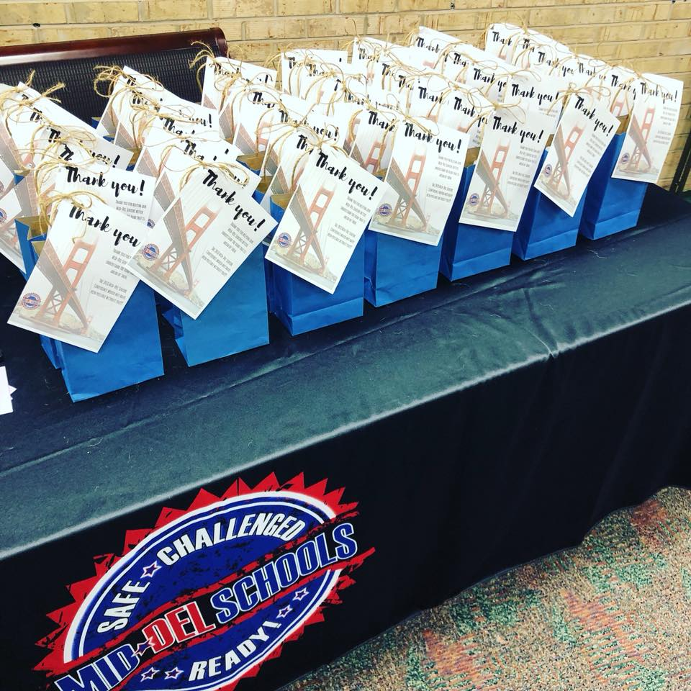

Slide 35
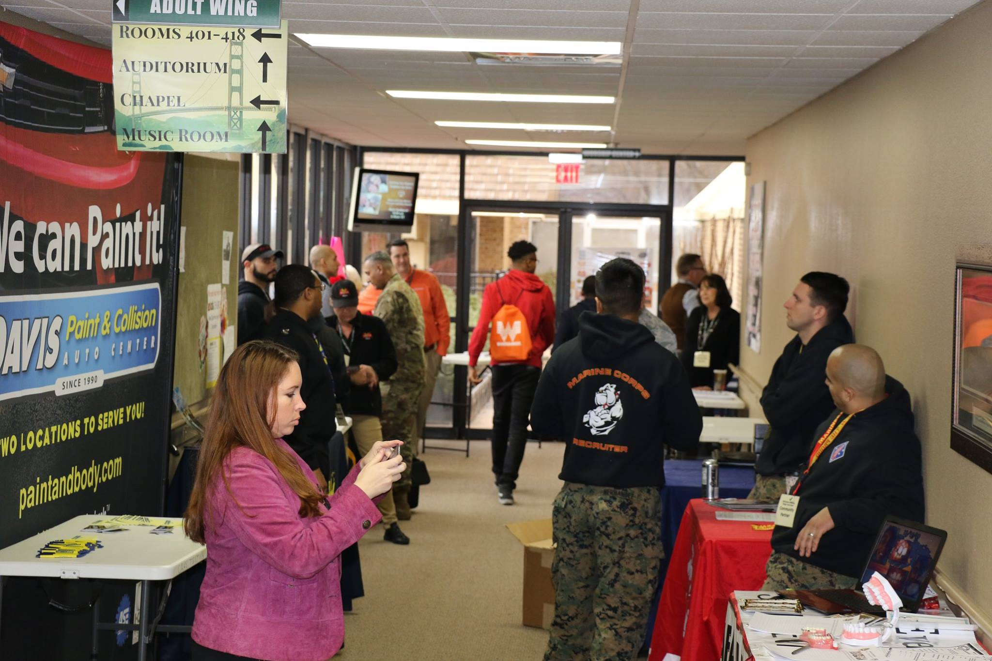

Slide 36
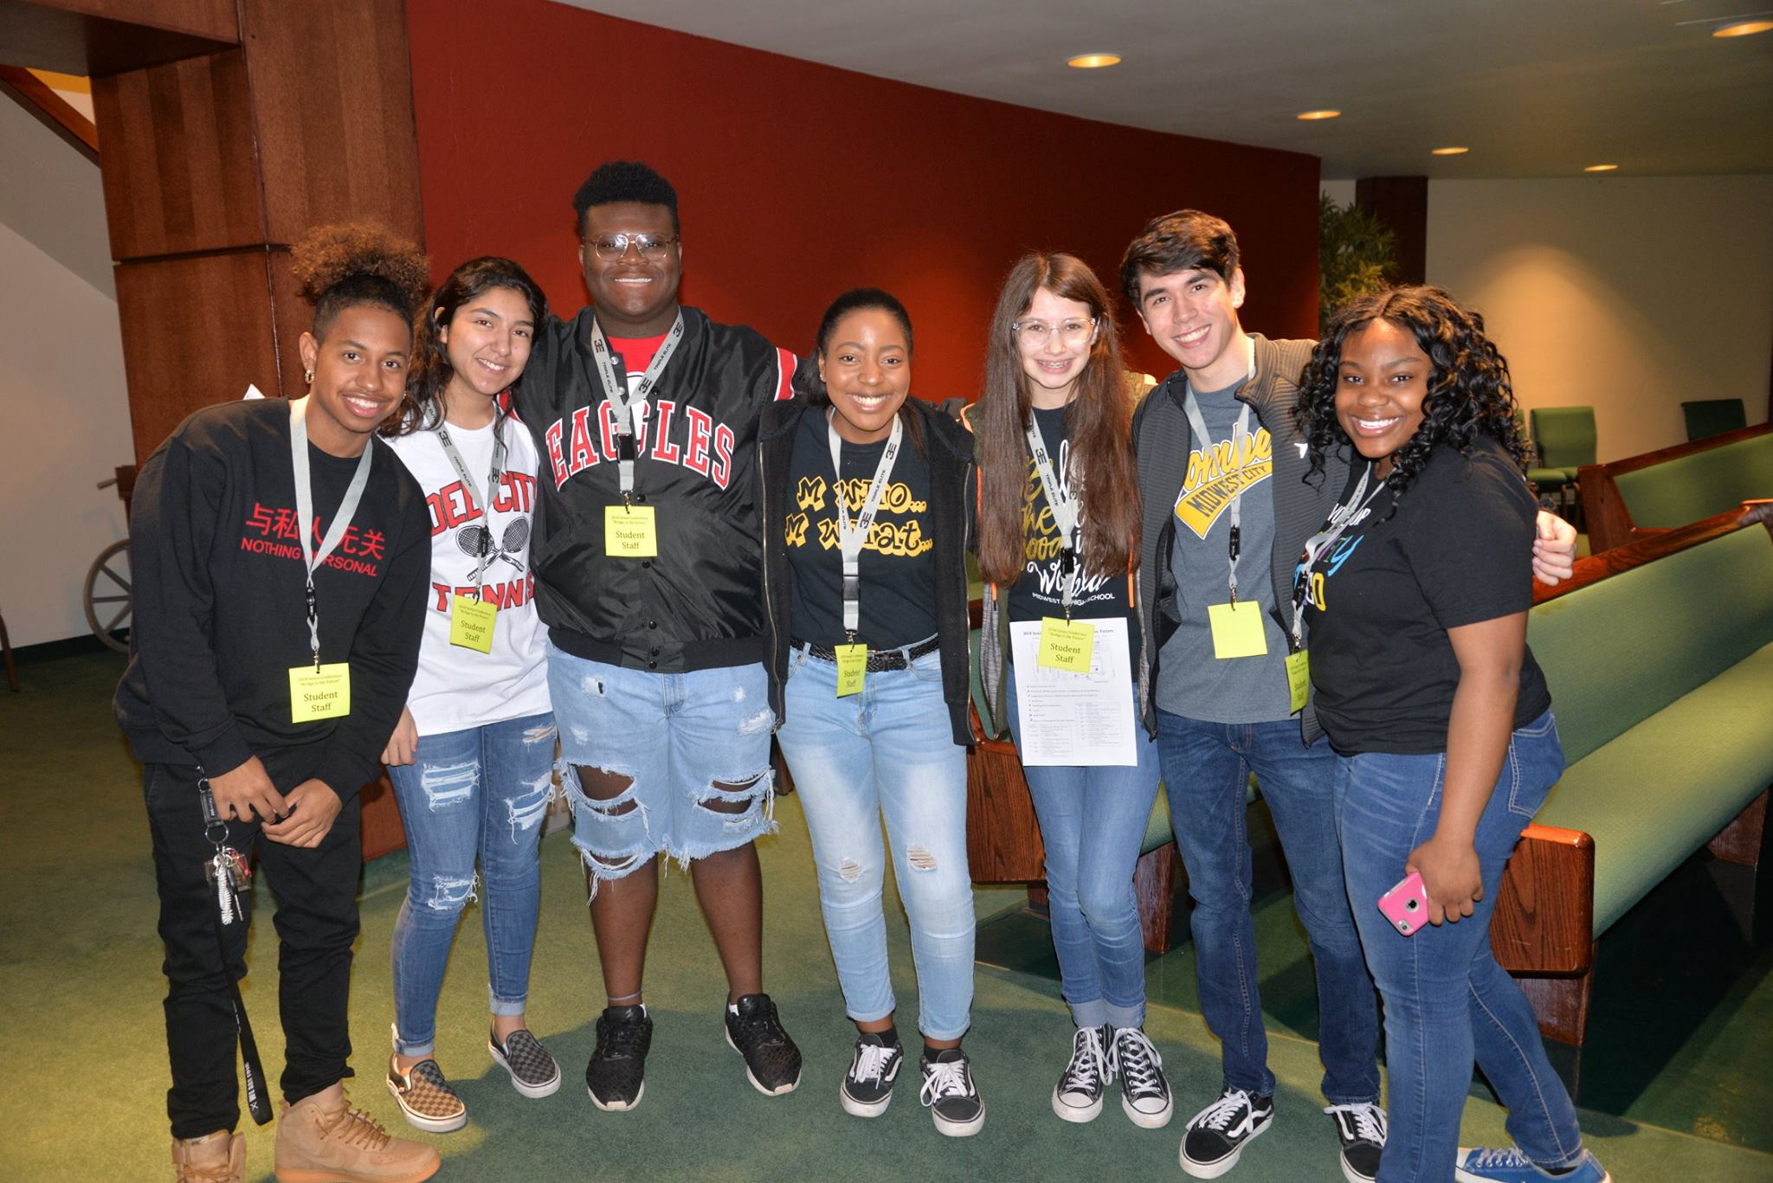

Slide 37
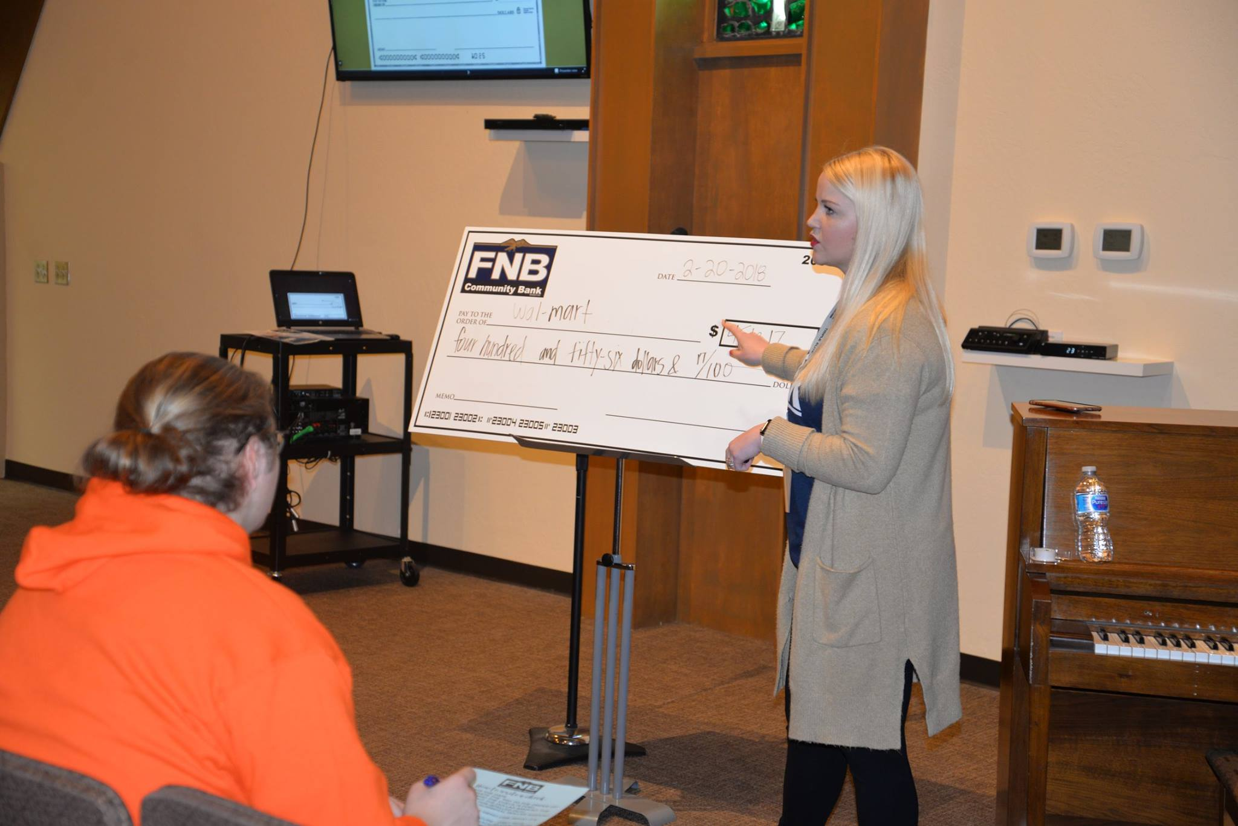

Slide 38
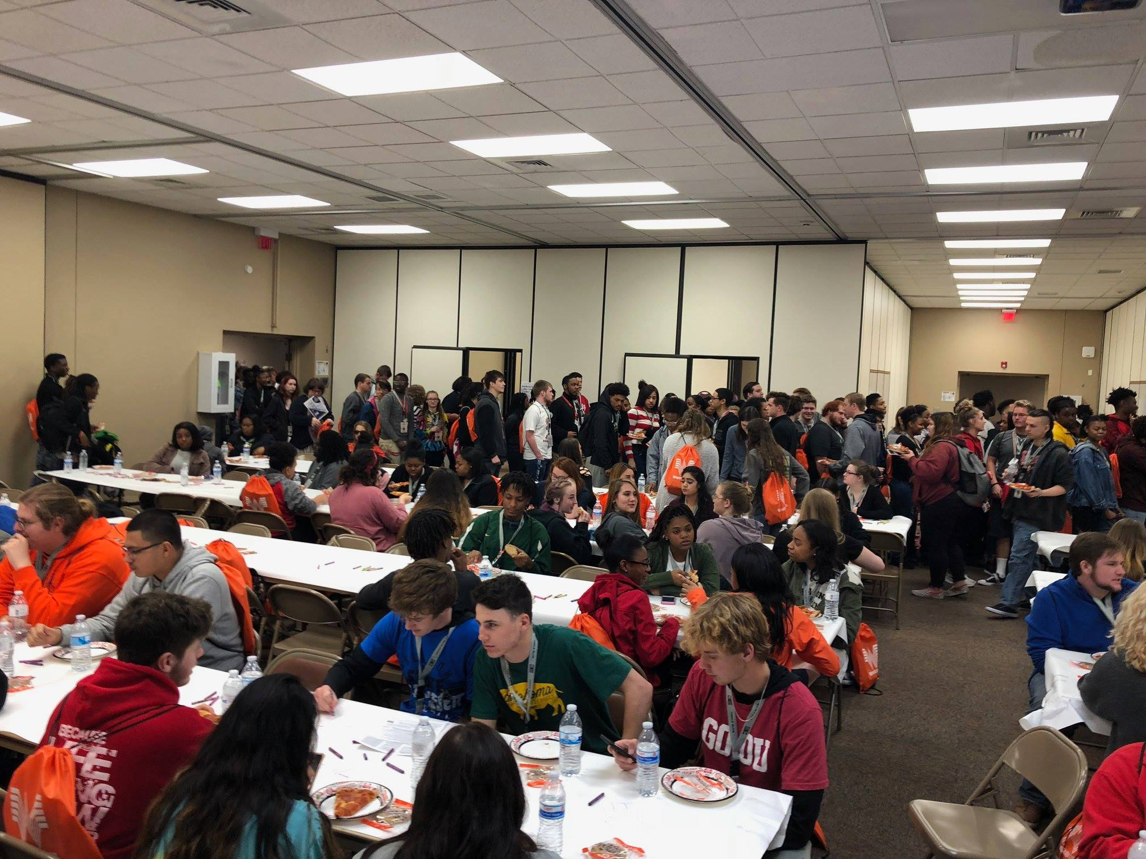

Slide 39
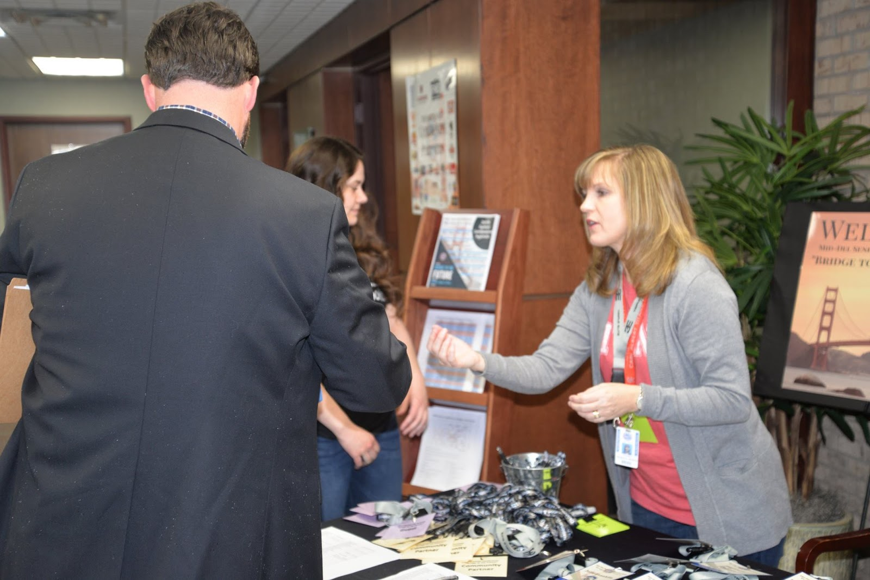

Slide 41
Thank You!
Meagan Bryant
mbryant@mid-del.net
Mdpdonyourplan.com

Slide 43
